Slide 1
Lora esp8266 Arduino project using Google assistant or Alexa

Slide 2
Abstract
This project explores the integration of Long Range (Lo Ra) communication technology with the ESP8266 microcontroller, enabling a smart home system controlled by voice commands through popular voice assistants like Google Assistant or Alexa. The ESP8266, equipped with Lo Ra transceiver modules, serves as a low-power, long-range communication bridge for smart devices within the home.
The key components of the project include Lo Ra-enabled sensors/devices, an ESP8266 microcontroller, and a central hub. The sensors/devices collect data related to the smart home environment, such as temperature, humidity, and door/window status, and transmit this information to the central hub using Lo Ra communication.
The ESP8266, acting as the central hub, receives data from the sensors and relays it to the cloud-based platforms associated with Google Assistant or Alexa. This allows users to interact with their smart home system using natural language voice commands via voice assistants.

Slide 3
Cont..
The project also involves the development of custom firmware for the ESP8266, integrating Lo Ra communication protocols and APIs provided by Google Assistant or Alexa. Additionally, the cloud-based platforms are configured to recognize and respond to specific voice commands, triggering actions on the ESP8266 and controlling connected smart devices.
This integration of Lo Ra with ESP8266 and voice assistants provides a scalable and energy-efficient solution for smart home applications, enabling users to remotely monitor and control their home environment using voice commands. The project contributes to the expanding field of IOT (Internet of Things) and demonstrates the potential of combining different technologies to create versatile and user-friendly smart home systems.

Slide 4
Introduction
Home, it is where one likes or wants to be following a long tiring day. Individuals return home depleted following a long dedicated day. Some are too worn out that they think that its difficult to move once they arrive on their love seat, couch or bed. So any little gadget/innovation that would enable them to switch theirs lights on or off, or play their preferred music and so forth on a go with their voice with the guide of their advanced mobile phones would make their home increasingly agreeable. Besides, it would be better if everything, for example, warming shower water and altering the room temperature were by then done previous to they accomplish their house just through give a voice direction. In this way, when individuals would arrive house, they would find out the room temperature, the shower water changed according to their reasonable inclinations, and they could remove up rapidly and feel cozier and rather, feel significantly progressively plain. Home automation is also named as domestics or Smart home. It incorporates the manage plus automation of light, warming, ventilation, cooling and security, similarly as home appliances. Wi-Fi will be most preferred for remote monitoring and control. Even now when technology is handy enough only the well to do people of the society are blessed with the new smart home devices such as Amazon Echo, Google Home etc, as these devices costs are a bit high. However, not everyone is wealthy enough to be able to afford a human assistant, or some smart home kit. Hence, the need for finding an inexpensive and smart assistant for normal families keep growing.

Slide 5
Cont..
This project proposes a very inexpensive system. It uses the Google Assistant, the IFTTT application and the NodeMCU esp8266 Wi-Fi microcontroller, the Adafruit application, as the major components along with a relay and other driver boards. Till now we have used Google Assistant to react to inquiries regarding atmosphere condition, cash rates, course, date and time, etc. Google Assistant can achieve something past answer these request. Presently we can utilize Google Assistant to control our home apparatuses by giving common language voice directions and with the assistance of adafruit application and IFTTT (If This Then That) application the directions are decoded and afterward sent to the microcontroller. All of the components are connected over the internet using Wi-Fi which puts this system under the IOT

Slide 6
Literature review
Azni et al. (2016) presented a wireless home automation system using Wi-Fi. The end user can control and monitor the home devices by using a web server or android application. It uses Restful Application Programming Interface (API) framework and other functions to use Hypertext Transfer Protocol (HTTP) request to control the General-purpose input/output (GPIO) of Raspberry PI. This system used to turn on/off the electrical appliances of home wirelessly through a Wi-Fi connection.
Jabbar et al. (2016) proposed a smart home system focuses on the utilization of the IBoard Adriano microcontroller and the XBee with the interface through Android smartphone application. The IBoard is a different Adriano board which have many features like Ethernet port, XBee socket interface, Micro SD socket and an ATMEGA32. Moreover, it works as web server connects the system to the network through Ethernet by the router and it allows a user to control the house appliances through an Android application. Android platform access by IP address and it consists of on/off button for switches and status declaration in addition to the automatic button for electronic work.

Slide 7
cont..
In 2017 P. N. Arathi proposed a model named gesture based home automation. Where the hand gesture sigh are captured by camera module and the processed with MATLAB algorithms. Practically common people cannot remember the sign of different switches this approach will not work effectively in public applications.

Slide 8
Existing system
In the existing system, home appliances are controlled through Bluetooth, Zigbee and other devices. But they are limited to certain area. In the proposed system we have designed so as to control home appliances from anywhere in the world.
DTMF can also be used but it won’t come for practically and also not reliable.

Slide 9
Proposed method
In the proposed system, we are using Arduino module which will generate devices according to the number of loads. The echo dot will able to identify hose devices while discovering devices. Once devices were found by echo dot, we can easily control it through mobile or by voice commands. When receive the voice value of LORA transmitter then transmits to the LORA receive the data, then lights and fan will be ON/OFF.

Slide 10
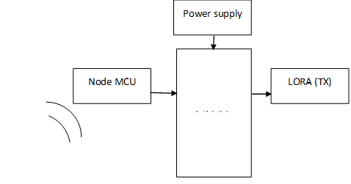
Block diagram (TX)

Slide 11
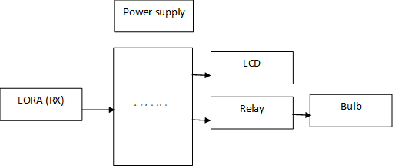
Block diagram(RX)

Slide 12
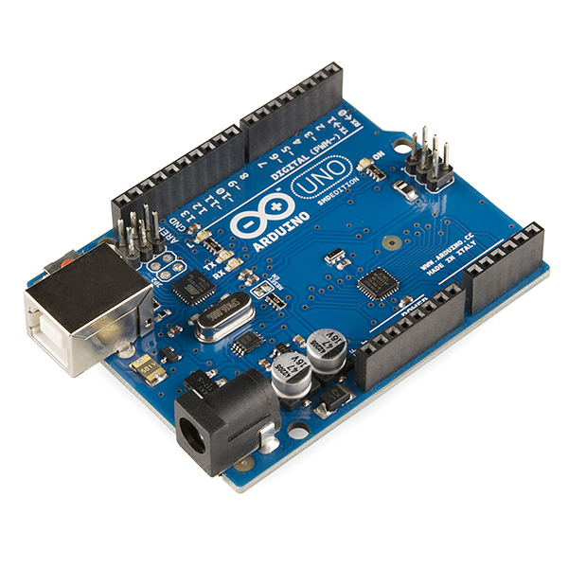
Arduino
The Uno with Cable is a micro-controller board base on the ATmega328. It has 14 digital input/output pins (of which 6 can be used as PWM outputs); 6 analog inputs, a 16 MHz ceramic resonator, a USB connection, a power jack, an ICSP header, and a reset button.
It contains everything need to support the microcontroller; simply connect it to a computer with a USB cable or power it with an AC-to-DC adapter or battery to get started.

Slide 13
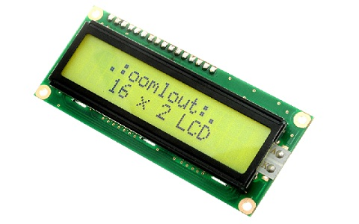
LCD
The term LCD stands for liquid crystal display. It is one kind of electronic display module used in an extensive range of applications like various circuits & devices like mobile phones, calculators, computers, TV sets, etc. These displays are mainly preferred for multi-segment light emitting diode and seven segments. The main benefits of using this module are inexpensive; simply programmable, animations, and there are no limitations for displaying custom characters, special and even animations, etc.

Slide 14
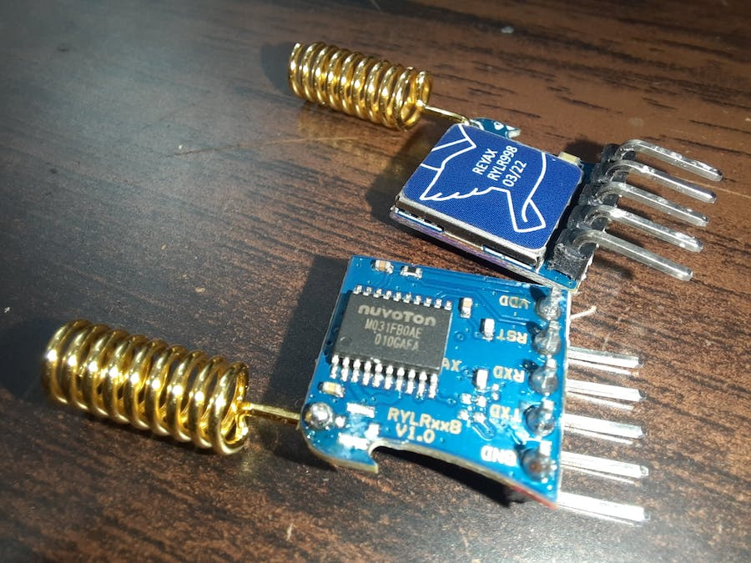
LORA
LoRa (short for long range) is a spread spectrum modulation technique derived from chirp spread spectrum (CSS) technology. Semtech’s LoRa devices and wireless radio frequency technology is a long range, low power wireless platform that has become the de facto technology for Internet of Things (IoT) networks worldwide. LoRa devices and the open LoRaWAN® protocol enable smart IoT applications that solve some of the biggest challenges facing our planet: energy management, natural resource reduction, pollution control, infrastructure efficiency, disaster prevention, and more. Semtech’s LoRa devices and the LoRaWAN protocol have amassed several hundred known uses cases for smart cities, smart homes and buildings, smart agriculture, smart metering, smart supply chain and logistics, and more. With well over 100 million devices connected to networks in 100 countries and growing, LoRa devices are the DNA of IoT, creating a Smarter Planet.

Slide 15
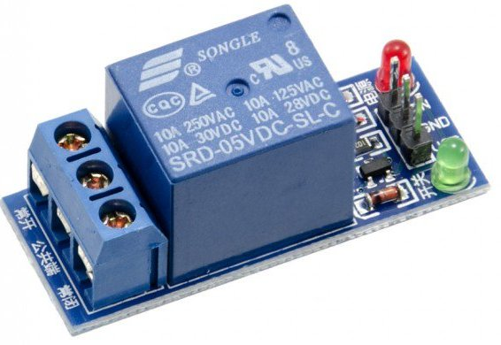
Relay
A relay is an electromagnetic switch that is used to turn on and turn off a circuit by a low power signal, or where several circuits must be controlled by one signal.
Pin Number | Pin Name | Description
1 | Coil End 1 | Used to trigger(On/Off) the Relay, Normally one end is connected to 5V and the other end to ground
2 | Coil End 2 | Used to trigger(On/Off) the Relay, Normally one end is connected to 5V and the other end to ground
3 | Common (COM) | Common is connected to one End of the Load that is to be controlled
4 | Normally Close (NC) | The other end of the load is either connected to NO or NC. If connected to NC the load remains connected before trigger
5 | Normally Open (NO) | The other end of the load is either connected to NO or NC. If connected to NO the load remains disconnected before trigger

Slide 16
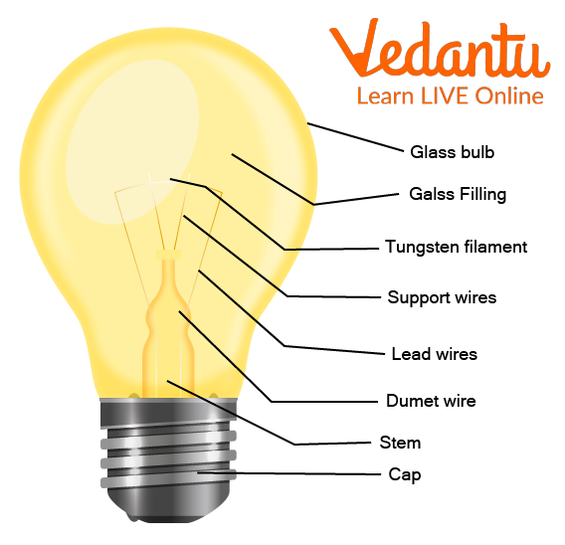
Bulb
The electronic bulb is the simplest electrical lamp that was invented for illumination more than a century ago. It was the small and simplest light that brightened the dark space. The electronic bulb is also known as an incandescent lamp, incandescent light globe or incandescent light bulb. Bulb comes in different sizes and light output and operates with a voltage range from 1.5 Volts to about 300 Volts.

Slide 17
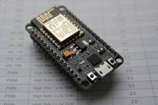
NODE MCU
Node MCU is an open-source firmware and development board based on the ESP8266 system-on-chip (SoC). It serves as a versatile platform for IoT (Internet of Things) projects, offering built-in Wi-Fi functionality and ease of programming. Node MCU combines a low-cost microcontroller with the capabilities of the Lua scripting language, providing a simple yet powerful tool for connecting hardware to the internet. Its compact design and integrated Wi-Fi module make it an ideal choice for various IoT applications, facilitating the development of smart devices and projects that require wireless connectivity.

Slide 18
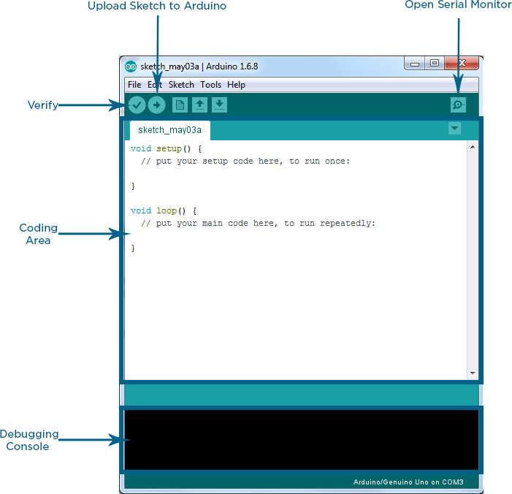
Arduino IDE
Arduino IDE where IDE stands for Integrated Development Environment – An official software introduced by Arduino.cc, that is mainly used for writing, compiling and uploading the code in the Arduino Device. Almost all Arduino modules are compatible with this software that is an open source and is readily available to install and start compiling the code on the go.

Slide 19
Advantages &Applications
Applications:
Used in homes, offices, industrial areas etc.,
Control home electrical system using phone.
Switch Module’s outputs to directly drive loads like bulbs, Lamps, Sockets, Television, and Fans etc.
Advantages:
Smart and secure.
Controlling home appliances from anywhere in the world.
There is no need for extra training of that person who is using it.
It is a robust and easy to use system.

Slide 20
Conclusion
The main aim of this project was to propose a considerably cost effective voice controlled (Google Assistant) home automation controlling generally all kind of home appliances found at home. The home automation utilizing IOT has been experimentally demonstrated to work attractive by connecting simple appliances to it and the appliances were effectively controlled remotely through internet using voice commands. This will help the users to monitor the condition of various home parameters in the home anytime anywhere.

Slide 21
Reference
1]IFTTT:https://www.pocketlint.com/SmartHome/Smar tHomenews
[2] adafruit io https://learn.adafruit.com/create-aninternet-of-things-dashboard-with-adafruit-dotio/introduction
[3]NodeMCU:https://nodemcu.readthedocs.io/en/master https://iotbytes.wordpress.com/nodemcupinout/
[4]GoogleAssistant: https://assistant.google.com/intl/en_in/ [4]IoT:https://internetofthingsagenda.techtarget.com/def inition/IoT-device
[5] Arduino IDE: https://www.arduino.cc/en/Guide/Environment
[6] Alkar, A. Z., & Buhur, U. (2005). An Internet Based Wireless Home Automation System for Multifunctional Devices. IEEE Consumer Electronics.
[7] Piyare, R. and Tazil, M. (2011) Bluetooth Based Home Automation System Using Cell Phone. IEEE 15th

